Slide 1

React Component in details
Lesson 07
Notes:
Add instructor notes here.

Slide 2
Lesson Objectives
At the end of this module you will
be able to:
Higher Order Components
Passing unknown Props
Validating Props
Using References
React Context API
Updated LifeCycle hooks (16.3)
Best practices for React Projects
Notes:
Add instructor notes here.

Slide 3
Nested Components
Components can be nested inside other components.
Components are self-contained, and thus enable to nest multiple components with one another.
React Component which has a child component is called as Top- level component.
var OuterComponent = React.createClass({ {/*Top level Component*/}
render:function(){
return(<div><InnerComponent/></div>) } });
var InnerComponent = React.createClass({
render:function(){
return (<div>Inner Component</div>)
} });
ReactDOM.render(<OuterComponent/>,document.getElementById('app'));
Notes:
Nested components in React.js help you create more complex view element structures.
React is moving away from React.createClass method.
Top level components can also be called as Controller View, because it controls the data flow for all its child component by setting props on children.
Add instructor notes here.

Slide 4
Nested Components
Nested components in React.js help you create more complex view element structures.
React is moving away from React.createClass method.
What gets to be in your component’s render function and/or in its return statement depends on the purpose of your application.
You can access child’s text from Parent method within Parent container.
Whatever you pass into the Child (which is located within Parent) will be automatically accessible via the parent container.
So props are really what establishes the relationship between the two.
Notes:
Nested components in React.js help you create more complex view element structures.
React is moving away from React.createClass method.
Top level components can also be called as Controller View, because it controls the data flow for all its child component by setting props on children.
Add instructor notes here.

Slide 5
Demo
Nested-Components
Notes:
Add instructor notes here.

Slide 6
Higher Order Components
A higher-order component (HOC) is an advanced technique in React for reusing component logic. HOCs are not part of the React API, they are a pattern that emerges from React’s compositional nature
A higher-order component is a function that takes a component and returns a new component.(also are referred as functional programming methodology).
Advantages:
Easy to test
Pass through
props unrelated to the HOC when you need a repeating pattern
Disadvantages:
Don’t use it inside render method
Do not mutate Original component
Don’t overuse this pattern
Notes:
HIGH ORDER COMPONENTS:
Helps to write out business logic
The goal of this HOC pattern is to decompose the logic into simpler and smaller functions that can be reused.
A rule of thumb is a function does just one task and does it well.
HOC makes debugging and maintenance a whole lot easier as they are modular.
Slide explains that communication between service provider and consumer happen via SOAP messages

Slide 7
Demo
Higher order components
React-higherorder-2019
Notes:
Add instructor notes here.

Slide 8
Working with props (Properties)
The props parameter is a JavaScript object (data & event handlers) passed from a parent element to a child element.
Props are supplied as attributes:
If the value of the attribute is JavaScript expression it must be enclosed in curly Brackets ({}).
If it is a string literal it must be enclosed with in double quotes ("").
Props can be accessed via props property inside a component.
Props are considered to be immutable;
Notes:
The props parameter is a JavaScript object (data & event handlers) passed from a parent element to a child element.
Props are supplied as attributes:
If the value of the attribute is JavaScript expression it must be enclosed in curly Brackets ({}).
If it is a string literal it must be enclosed with in double quotes ("").
Props can be accessed via props property inside a component.
Props are considered to be immutable; it stores read-only data that is passed from the parent. It belongs to the parent and cannot be changed by its children.
getDefaultProps() specifies property values to use, if they are not explicitly supplied.
Parent can read its children by accessing the special this.props.children prop.
Note : this.props.children is an opaque data structure, use the React.Children utilities to manipulate them.
Add instructor notes here.
// Props supplied as attributes
<Sample math={Math.pow(2,3)} name="Veena Deshpande" />
// Access Props via the props property
this.props.math, this.props.name
//SampleComponent has text "Karthik" has its children which can be accessed via //this.props.children in the component
<SampleComponent>Karthik</SampleComponent>

Slide 9
it stores read-only data that is passed from the parent. It belongs to the parent and cannot be changed by its children.
getDefaultProps() specifies property values to use, if they are not explicitly supplied.
Parent can read its children by accessing the special this.props.children prop.

Slide 10
Demo
Using-Props
Create-React-props
Notes:
Add instructor notes here.

Slide 11
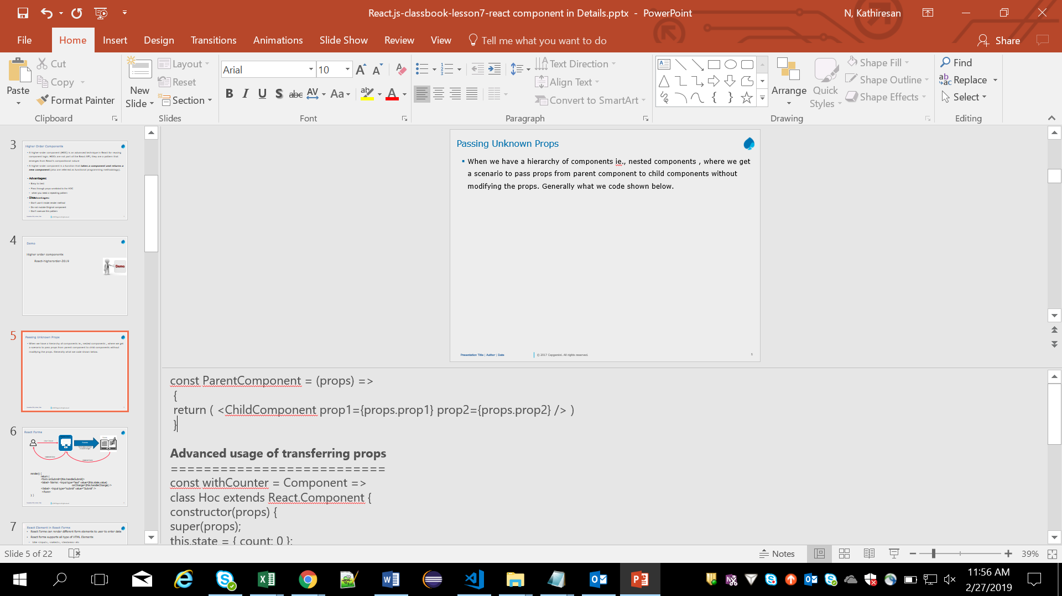
Passing Unknown Props
When we have a hierarchy of components ie., nested components , where we get a scenario to pass props from parent component to child components without modifying the props. Generally what we code shown below.
But there is an easy and alternate approach to do this is by using Spread operator .
Notes:
const ParentComponent = (props) => {
return (
<ChildComponent {...props} />
) }
Advanced usage of transferring props
==========================
const withCounter = Component => class Hoc extends React.Component { constructor(props) { super(props); this.state = { count: 0 }; } update = type => { if (type === "Inc") { this.setState(({ count }) => ({ count: count + 1 })); } else if (type === "Dec") { this.setState(({ count }) => ({ count: count - 1 })); } }; render() { return <Component {...this.state} {...this.props} update={this.update} />; } };

Slide 12

Passing Unknown Props
This syntax is much easier, less error prone, and it allows flexibility, since you don’t need to change the props names or add props in the intermediate component when you change them
Notes:
const ParentComponent = (props) => {
return (
<ChildComponent {...props} />
) }
Advanced usage of transferring props
==========================
const withCounter = Component => class Hoc extends React.Component { constructor(props) { super(props); this.state = { count: 0 }; } update = type => { if (type === "Inc") { this.setState(({ count }) => ({ count: count + 1 })); } else if (type === "Dec") { this.setState(({ count }) => ({ count: count - 1 })); } }; render() { return <Component {...this.state} {...this.props} update={this.update} />; } };

Slide 13
JSX Spread Attributes
The ... operator is called as spread operator.
Using JSX Spread Attributes, we can construct the props before creating the components and pass them later to the components.
The properties of the object that passed in are copied onto the component's props.
We can transfer it multiple times, combine it with other attributes and override the value.
var props = {};
props.foo = x;
props.bar = y;
var component = <Component {...props} />;
var props = { foo: 'default' };
var component = <Component {...props} foo={'override'} />;
console.log(component.props.foo); // 'override'
Notes:
Add instructor notes here.

Slide 14
Demo
React-Spread-attr-2019
Notes:
Add instructor notes here.

Slide 15
Prop Validation
React offers a great suite of validators for checking the props set for a component are as expected.
React.PropTypes exports a range of validators that can be used to make sure the data you receive is valid.
React supports validation of existence, data type or a custom condition.
Using the following prop types we can validate whether a prop:
is required
contains a primitive type
contains something renderable (a node)
is a React Element
contains one of several defined types
is an array containing only items of a specified type
contains an instanceof a class
contains an object that has a specific shape
Notes:
Prop validations helps us to :
Immediately see what data a component can process
propTypes can serve as a sort of mini-reference to your back-end’s API by just looking at the code of the component. This eliminates needing to switch between looking at the API documentation and your component code.
Get console warnings if a component receives an incorrect or missing data type
If a prop is missing, or has an incorrect data type, you’ll see a warning in the JavaScript console. React will only check the propTypes in development mode.
Check whether API Data is Changed
It is often the case as a project grows, that the structure of a back-end API response could change, and therefore break an element in the UI if that piece of data is missing, or if a new property is added. Having propTypes can eliminate a whole swath of these kinds of errors. If a new property is added which is not defined in proptype, the console would warn to re-examine the data we’re getting from this.props, and update our prop checks accordingly.
Ensure strong type checking
Enforcing types in JS is tricky business, but with the proper use of propTypes can really minimize this. prop checks can drastically improve long-term productivity and coerce the code to seem more strongly typed.
Example:
import PropTypes from 'prop-types'
import React from 'react'
class Blogs extends Component {
render() {
return (
<div>
<h1>{this.props.title}</h1>
<p>{this.props.description}</p>
</div>
)
}
}
Blogs.propTypes = {
title: PropTypes.string,
description: PropTypes.string
}
export default Blogs;
Add instructor notes here.

Slide 16
For performance reasons propTypes is only checked in development mode.
eg:
MyComponent.propTypes = {
children: PropTypes.element.isRequired
};

Slide 17
Demo
Using-Props
create-react-props-validation
react-proptypes
Notes:
Add instructor notes here.

Slide 18
Using Refs
Refs are introduced in React 16.3.
Refs provide a way to access DOM nodes or React elements created in the render method.
Generally, refs can be used only when not able to something through state and props.
When to use refs:
Integrating with third-party DOM libraries
Managing focus, handling text selections or media playback behavior.
Triggering imperative animations
The ref is first set after the first render(), but before componentDidMount().
Notes:
React dataflow, props are the only way that parent components interact with their children.
React provides three major ways of creating refs. Here is a list of the different methods starting from the oldest of them:
String Refs (legacy method)
Callback Refs
React.createRef (from React 16.3)
Prior to React v16.3 the callback ref were the preferred way to create and use refs.

Slide 19
Disadvantages of Ref:
It hinders in optimized working of Babel inline plugin
Once state changes, you re-render all the components of your UI that depend on that state.

Slide 20
Demo
react-refs-2019
Notes:
Add instructor notes here.

Slide 21
Accessing User Input With refs
React provides two standard ways to grab values from <form> elements. The first method is to implement what are called controlled components The second is to use React's ref property.
Ex:
We can also use for radio box, check box.
The primary value of using refs over controlled component is that, in most cases, you will write less code.
<input type="text" ref={input => this.fullName = input}/>
<input type="number" ref={cashMoney => this.amount = cashMoney} />
Notes:
Controlled components are heavy duty. The defining characteristic of a controlled component is the displayed value is bound to component state. To update the value, you execute a function attached to the onChange event handler on the form element and updates the state property, which in turn updates the form element's value.
An easier and less labor-intensive way to grab values from a form element is to use the ref property.
Use Refs on any one of the scenario’s
Managing focus, text selection, or media playback.
Triggering imperative animations.
Integrating with third-party DOM libraries.
Your first inclination may be to use refs to “make things happen” in your app. If this is the case, take a moment and think more critically about where state should be owned in the component hierarchy. Often, it becomes clear that the proper place to “own” that state is at a higher level in the hierarchy
So avoid mostly using refs, because it may overhead the process
They're bad for maintainability, and lose a lot of the simplicity
For drop down:
<select ref={select => this.petType = select} name="petType"> <option value="cat">Cat</option> <option value="dog">Dog</option> <option value="ferret">Ferret</option> </select>
Note
The examples below have been updated to use the React.createRef() API introduced in React 16.3. If you are using an earlier release of React, we recommend using callback refsinstead.

Slide 22
Demo
Create-react-forms-inputrefs
Notes:
Add instructor notes here.

Slide 23
Context API
Context provides a way to pass data through the component tree without having to pass props down manually at every level.
This is called as props-drilling
MyTag
Head
Title
props
props
props
Index includes MyTag component
index
Second
Tag
Here index,MyTag,SecondTag,head,title are component js files
Props has to be carry forwarded from MyTag to Head, Head to Title(props-drilling)
React’s context API gives you a solution for props –drilling , instead of passing down the props explicitly down to each component you can store the data needed by every Component in React’s context and pass them to all other components implicitly.
If a component needs access to the context, it can consume it on demand.
Notes:
Passing props down the component tree - Props drilling
Context provides a way to share values like this between components without having to explicitly pass a prop through every level of the tree.

Slide 24
Context continued…
After usage of react’s Context Api
MyTag
Provides Context
(common data)
Head
Title
Index includes MyTag component
index
Second
Tag
Here index,MyTag,SecondTag,head,title are component js files
MyTag stores the common data in context and are utilized by head and Title components
When to Use Context
Context can be used when data that can be considered “global” for a tree of React components. such as the current authenticated user, theme(css), company details or preferred language.

Slide 25
Context Continued….
React Context has 2 components
Consumer
Provider
To access these 2 components, we have to create Context object
createContext()
const GradeContext = React.createContext(‘grades’);
Consumer :
Provider:
<ThemeContext.Provider value={'green'}>
<D />
</ThemeContext.Provider>
<ThemeContext.Consumer>
{coloredTheme =>
<div style={{ color: coloredTheme }}>
Hello World
</div> }
</ThemeContext.Consumer>
Notes:
For create Context() method , there is single argument :
the initial value is can be null, or if you need a default value provide it as argument.
React.createContext(null);
The value is set to null, so later we can set the value
React.createContext(‘grades’); -→ here grades is considered as initial value
Context is similar to props except that a change in context doesn't actually trigger a render. Usually context takes its value from a state or a store so that's usually not a problem. Another downside is unlike props, React doesn't provide a way to set a default value for it.
Validasting child context Types:
// Define types of elements in context // We define it the same way as `propTypes` childContextTypes: { eventBus: React.PropTypes.object.isRequired },

Slide 26
Demo
Demos of
Create-react-context2
Notes:
Add the notes here.
Add instructor notes here.

Slide 27
React Updated LifeCycle hooks
ReactJs v16.3 introduced significant changes in component lifecycle. In React 16.3 few lifecycle methods have been deprecated. Those methods are prefixed by UNSAFE_.
Methods like componentWillMount, componentWillReceiveProps and
componentWillUpdate were heavily misused because the current instance this was available and is easy to misuse.
latest React component lifecycle
The React component which extends React.Component goes through the following phases:
Mounting
Updating
Unmounting
Notes:
React Team decided to move onto static lifecycle methods and started seeking to improve the UX and performance of React, they moved towards async rendering.
componentWillMount All the legacy use cases are covered in the constructor. This is renamed as UNSAFE_componentWillMount.
componentWillReceiveProps The new static method getDerivedStateFromProps is safe rewrite for this method and covers all the use cases of componentWillReceiveProps. The new name for this method is UNSAFE_componentWillReceiveProps.
componentWillUpdate The new method getSnapshotBeforeUpdate is safe rewrite for this method and covers all the use cases of componentWillUpdate. The new name for this method is UNSAFE_componentWillUpdate.

Slide 28
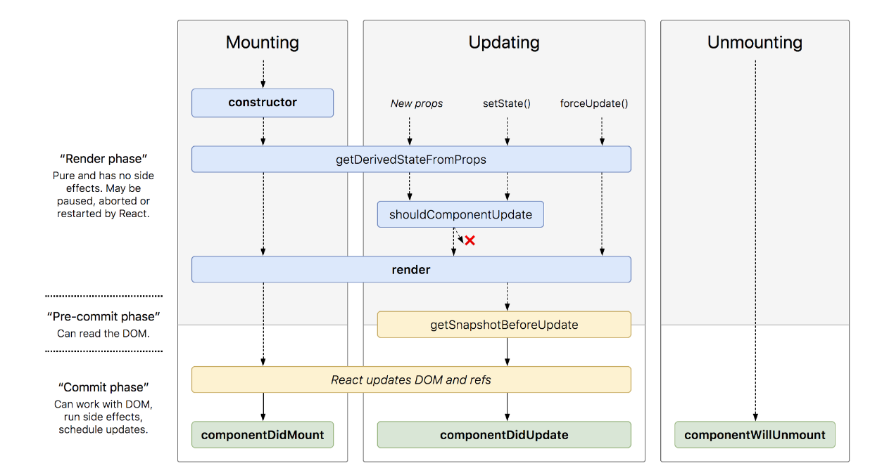
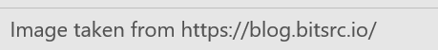
React Updated LifeCycle hooks contd.
latest React component lifecycle
The React component which extends React.Component goes through the following phases:
Mounting
Updating
Unmounting
Notes:
Image taken from https://blog.bitsrc.io/

Slide 29
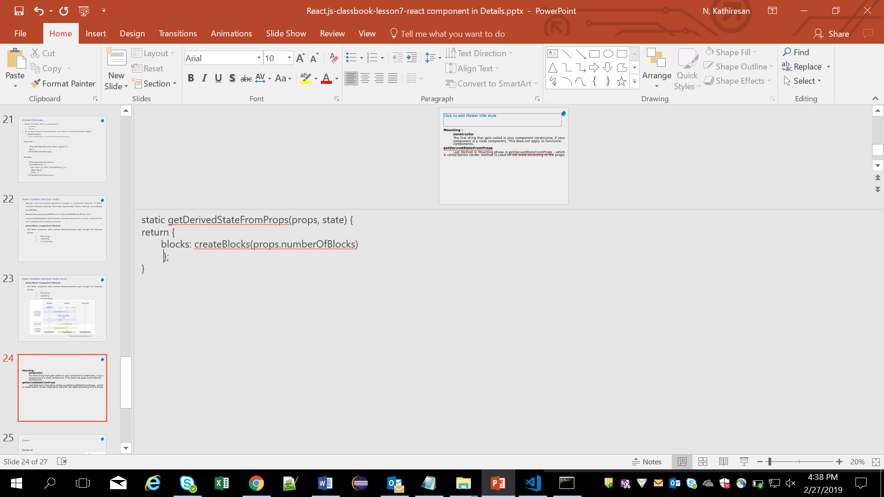
Lifecycle hooks contd.
Mounting :
constructor
The first thing that gets called is your component constructor, if your component is a class component. This does not apply to functional components.
getDerivedStateFromProps
Last Method in Mounting phase is getDerivedStateFromProps , which is called before render method and is used for set state according to the props. whenever the props are changed the state has to be kept in sync. This method is a safer replacement of componentWillReceiveProps
Notes:
getDerivedStateFromProps:
The method getDerivedStateFromProps is static, hence it has no access to this. This method has access to the current state and props.

Slide 30
Life cycle hooks contd.
render
Rendering does all the work. It returns the JSX of your actual component.
componentDidMount
This is the hook method which is invoked immediately after the component did mount on the browser DOM. If we need to load any data we can do here. API calls should be made in this method.
2. Updating
This Phase starts whenever React Component needs to be updated with the changes. They can be updated in 2 ways.
1. sending new props from parents
2. updating the current state
Notes:
Updating:
Components must be re-rendered only if any changes happens in props changes

Slide 31
static getDerivedStateFromProps This method behaves exactly as defined above in mounting phase
shouldComponentUpdate This method tells React that when the component is being updated, it should re-render or ignore rendering. The method returns true or false based on which component is re-rendered or ignored.
Render:
Again render method is called to to display component in browser

Slide 32
Life cycle hooks contd.
getSnapshotBeforeUpdate
This method gets called after the render created the React element and before it is actually updated from virtual DOM to actual DOM. This phase is known as pre-commit phase.
componentDidUpdate is executed when the newly updated component has been updated in the DOM. This method is used to re-trigger the third party libraries used, and to make sure these libraries also update and reload themselves.
3) Unmounting
In this phase, the component is not needed and the component will get unmounted from the DOM. Below method is called
componentWillUnmount :
This method is the last method in the lifecycle. This is executed just before the component gets removed from the DOM.
Notes:
getSnapshotBeforeUpdate
Usage: This method is useful if you want to keep sync in-between state of current DOM with the updated DOM. E.g. scroll position, audio/video, text-selection, cursor position, tool-tip position, etc.
ComponentWillUnmount:
Usage: In this method, we do all the cleanups related to the component.

Slide 33
Best Practices in React Js
Don’t duplicate source of truth — props in initial state is an anti pattern
The state should be avoided as much as possible. It is a good practice to centralize the state and pass it down the component tree as props. Use Flux pattern for Handling the state.
The PropTypes should always be defined. This will help is track all props in the app and it will also be useful for any developer working on the same project.
Try to write application logic in render method. Do any kind of processing from state or props in render method only.
Follow a single responsibility principle.ie use one component to do one task/functionality only.
Don’t unnecessarily use context or have your application tied to it
Notes:
Don’t duplicate source of truth :
constructor(props){ super(props); this.state = { myname: props.name, }; }
If you pass in new props.name it wont be used because its only invoked when the component is first created — DON’T do this.
Donot use Context Api much or put most of application data in context api as its not supported with shouldComponentUpdatelife cycle hook

Slide 34
If performance is a concern — avoid recreating functions or objects in your render
Don’t use state when you can use props or local instance variables
Prior react versions used mixins for handling reusable functionalities.As they are deprecated now, alternate solution has been provided, nothing but HOC(Higher Order Components)
React Dev Tools is an excellent way to explore our React components and helps diagnose any issues in your app.
Use Inline Conditional Statements
Stateless functional components can be used when there is no need for state, refs, or lifecycle methods. Use it only to return jsx.
Use PureComponent rather than a Component to prevent things from having an unnecessary re-render.
Notes:
Inconditional statements example:
<div> {isRole('admin', user.id) && <UserProfile userId={user.id} /> }</div>
The above code avoids writing a function for checking role
React Dev tools:
React Dev Tools are available for all major browsers such as Chrome and Firefox.

Slide 35
Demo
Demos of
React-lifecycle-old
react-lifecycle-2019
react-lifecycle-2019_2
Notes:
Add the notes here.
Add instructor notes here.

Slide 36
Summary
After this you should be clear with
Higher Order Components
Passing unknown Props
Validating Props
Using References
React Context API
Updated LifeCycle hooks (16.3)
Notes:
Add the notes here.
Add instructor notes here.

Slide 37
Review:
______provides a way to pass data through the component tree without having to pass props down manually at every level. ?
1. Context
2. Props
3. input ref’s
4. routing
Is Mounting a life cycle of react Component?
1.True
2.False

